Slide 1
Chapter 4

Slide 2
What is classification?
is a data mining technique used to predict the category of categorical data by building a model based on some predictor variables (to classify data).
Predictor variable/attribute is called class label attribute (predefined class)

Slide 3
What is classification?
It is a two-step process
Model Construction (learning step or training phase)
- build a model to explain the target concept
- model is represented as classification rules, decision trees, or mathematical formulae.
Model Usage
- is used for classifying future or unknown cases
- estimate the accuracy of the model

Slide 4
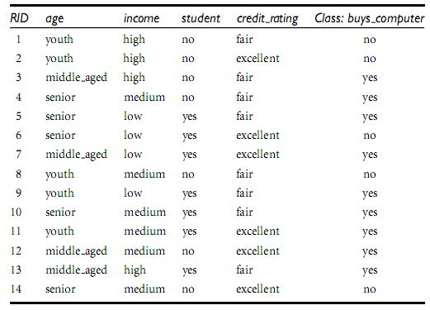
Example

Slide 5
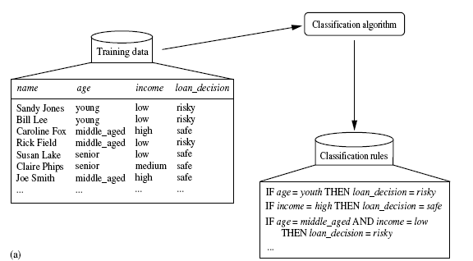
Step 1
Loan application

Slide 6
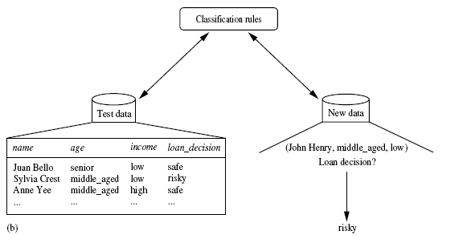
Step 2
Accuracy
classification

Slide 7
Example of a Decision Tree
categorical
categorical
continuous
class
Splitting Attributes
Refund
Yes
No
NO
MarSt
Single, Divorced
Married
TaxInc
NO
< 80K
> 80K
NO
YES
Training Data
Model: Decision Tree

Slide 8
Another Example of Decision Tree
categorical
categorical
continuous
class
MarSt
Single, Divorced
Married
NO
Refund
Yes
No
NO
TaxInc
< 80K
> 80K
NO
YES
There could be more than one tree that fits the same data!

Slide 9
Decision Tree Classification Task
Decision Tree

Slide 10
Apply Model to Test Data
Test Data
Start from the root of tree.
Refund
Yes
No
NO
MarSt
Single, Divorced
Married
TaxInc
NO
< 80K
> 80K
NO
YES

Slide 11
Apply Model to Test Data
Test Data
Refund
Yes
No
NO
MarSt
Single, Divorced
Married
TaxInc
NO
< 80K
> 80K
NO
YES

Slide 12
Apply Model to Test Data
Test Data
Refund
Yes
No
NO
MarSt
Single, Divorced
Married
TaxInc
NO
< 80K
> 80K
NO
YES

Slide 13
Apply Model to Test Data
Test Data
Refund
Yes
No
NO
MarSt
Single, Divorced
Married
TaxInc
NO
< 80K
> 80K
NO
YES

Slide 14
Apply Model to Test Data
Test Data
Refund
Yes
No
NO
MarSt
Single, Divorced
Married
TaxInc
NO
< 80K
> 80K
NO
YES

Slide 15
Apply Model to Test Data
Test Data
Refund
Yes
No
NO
MarSt
Single, Divorced
Married
Assign Cheat to “No”
TaxInc
NO
< 80K
> 80K
NO
YES

Slide 16
Decision Tree Classification Task
Decision Tree

Slide 17
What is Prediction?
models continuous-valued functions, i.e. predicts unknown or missing values (numeric)
lost terminology of “class label attribute”, instead we use “predicted attribute”
viewed as a mapping or function y = f(X)
Example: predict the amount (in dollars) that would be safe for the bank to loan an application

Slide 18
Supervised & Unsupervised Learning
Supervised Learning (Classification)
Supervision: The training data are accompanied by labels indicating the class of the observations
New data is classified based on the training set
Unsupervised Learning (Clustering)
The class labels of training data is unknown
Given a set of measurements, observations, etc. with the aim of establishing the existence of classes or clusters in the data

Slide 19
Issue regarding classification & Prediction
Data Preparation
data cleaning, relevant analysis, data transformation and reduction
Comparing classification & prediction method
Accuracy, speed, Robustness, scalability, interpretability

Slide 20
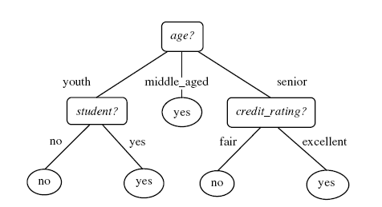
Classification by decision tree induction
What is decision tree?
flow chart like tree structure
internal node denotes a test on an attribute
each branch represents an outcome of the test
each leaf node holds a class label
Decision tree for the concept buys computer

Slide 21
Why decision tree?
Construction does not require any domain knowledge
Can handle high dimensional data
Learning step is simple and fast
In general have good accuracy
People are able to understand decision tree models after a brief explanation

Slide 22
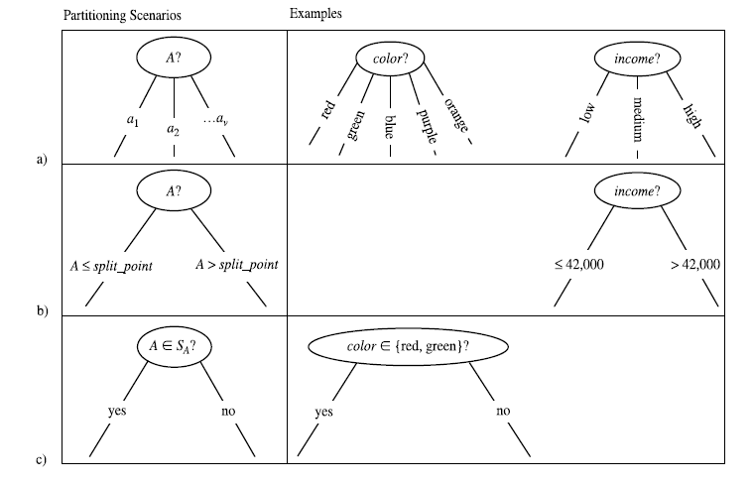
Example
Discrete-valued
Continuous-valued
Discrete-valued

Slide 23
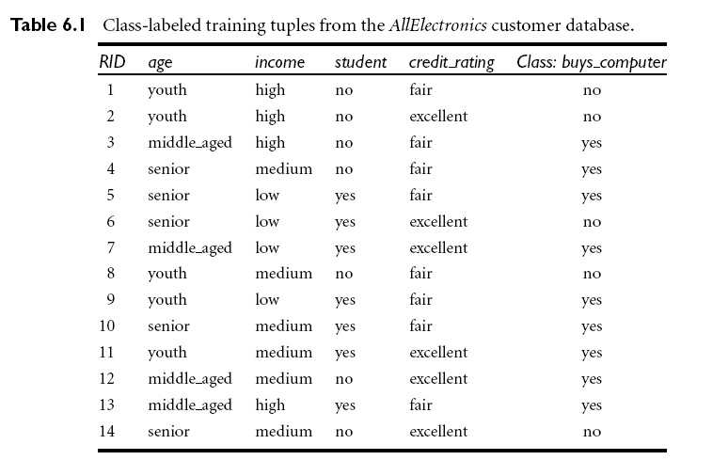
Attribute selection measures
Information Gain, gain ratio and gini index

Slide 24


Attribute selection measures
Information Gain
the expected information needed to classify a tuple in D : (entropy of D)
Pi = |Ci,D| / |D|
A having v distinct values, {a₁, a₂, …, a_{v}}
D₁, D₂, …, D_{v}

Slide 25

Attribute selection measures
(Choose maximum value)

Slide 26

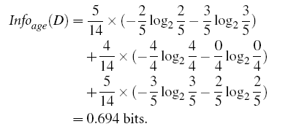
Example A is discrete-valued
Grain(income)=0.029, Grain(student)=0.151, Grain(credit_rating)=0.048
➔Age

Slide 27
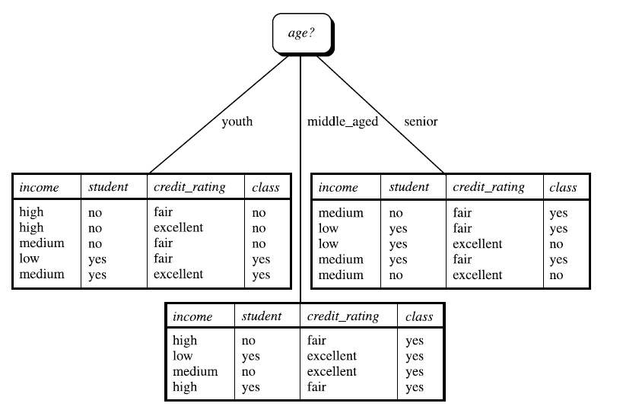

Slide 28


Gain ratio
choose maximum gain ratio
Note, however, that as the split information approaches 0, the ratio becomes unstable.
So a constraint is added to avoid this:
information gain of the test selected must be large—at least as great as the average gain over all tests examined.

Slide 29
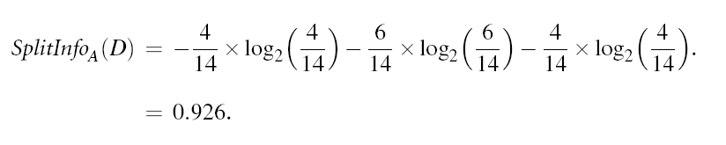
Example
A = income (low, medium, high)
➔ GrainRatio(income)= 0.029/0.926 = 0.032

Slide 30

Gini Index
P_{i} is the probability that a tuple in D belongs to class Ci
P_{i} = |C_{i,D} | / |D|
A is discrete-valued
- A : {a1, a2, : : : , av}
- and 2^v - 2 possible
Ex: income {low, medium, high}
➔ {low, medium}, {low, high}, {medium, high}, {low}, {medium}, {high}

Slide 31

Gini Index
Ex: if a binary split on A partitions D into D1 and D2, the gini index of D given that partitioning is
➔ Choose the subset that gives the minimum gini index as splitting subset.

Slide 32

Gini Index
A is continuous-valued
Each possible split point must be considered
D1 is the set of tuples in D satisfying
A <= split point
D2 is the set of tuples in D satisfying
A > split point
The reduction in impurity
➔ Attribute that maximizes the reduction in impurity

Slide 34
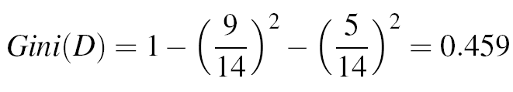
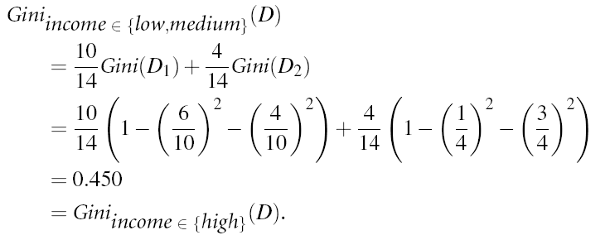
Example
Yes
No

Slide 35
Biased
Information gain is biased toward multivalued attributes.
Gain ratio tends to prefer unbalanced splits in which one
partition is much smaller than the others.
Gini index is biased toward multivalued and has difficulty
when the number of classes is large.

Slide 36
Tree Pruning
When a decision tree is built, many of the branches will reflect anomalies in the training data due to noise or outliers. Tree pruning methods address this problem of overfitting the data.
There are two common approaches for tree pruning
Pre-pruning (early stopping rule):
the tree is “pruned” by halting its construction early
Or stop algorithm before it becomes a fully grown tree
Most popular test: chi-squared test

Slide 37
Tree Pruning
Post-pruning
removes sub-trees from a “fully grown” tree: get a sequence of progressively pruned trees
Possible strategies: error estimation, significance testing, MDL pruning
preferred in practice

Slide 38
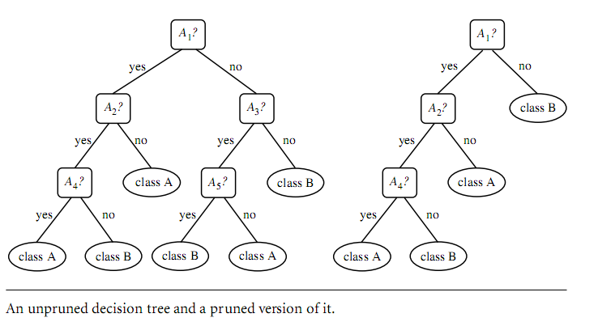
Example..

